Slide 1
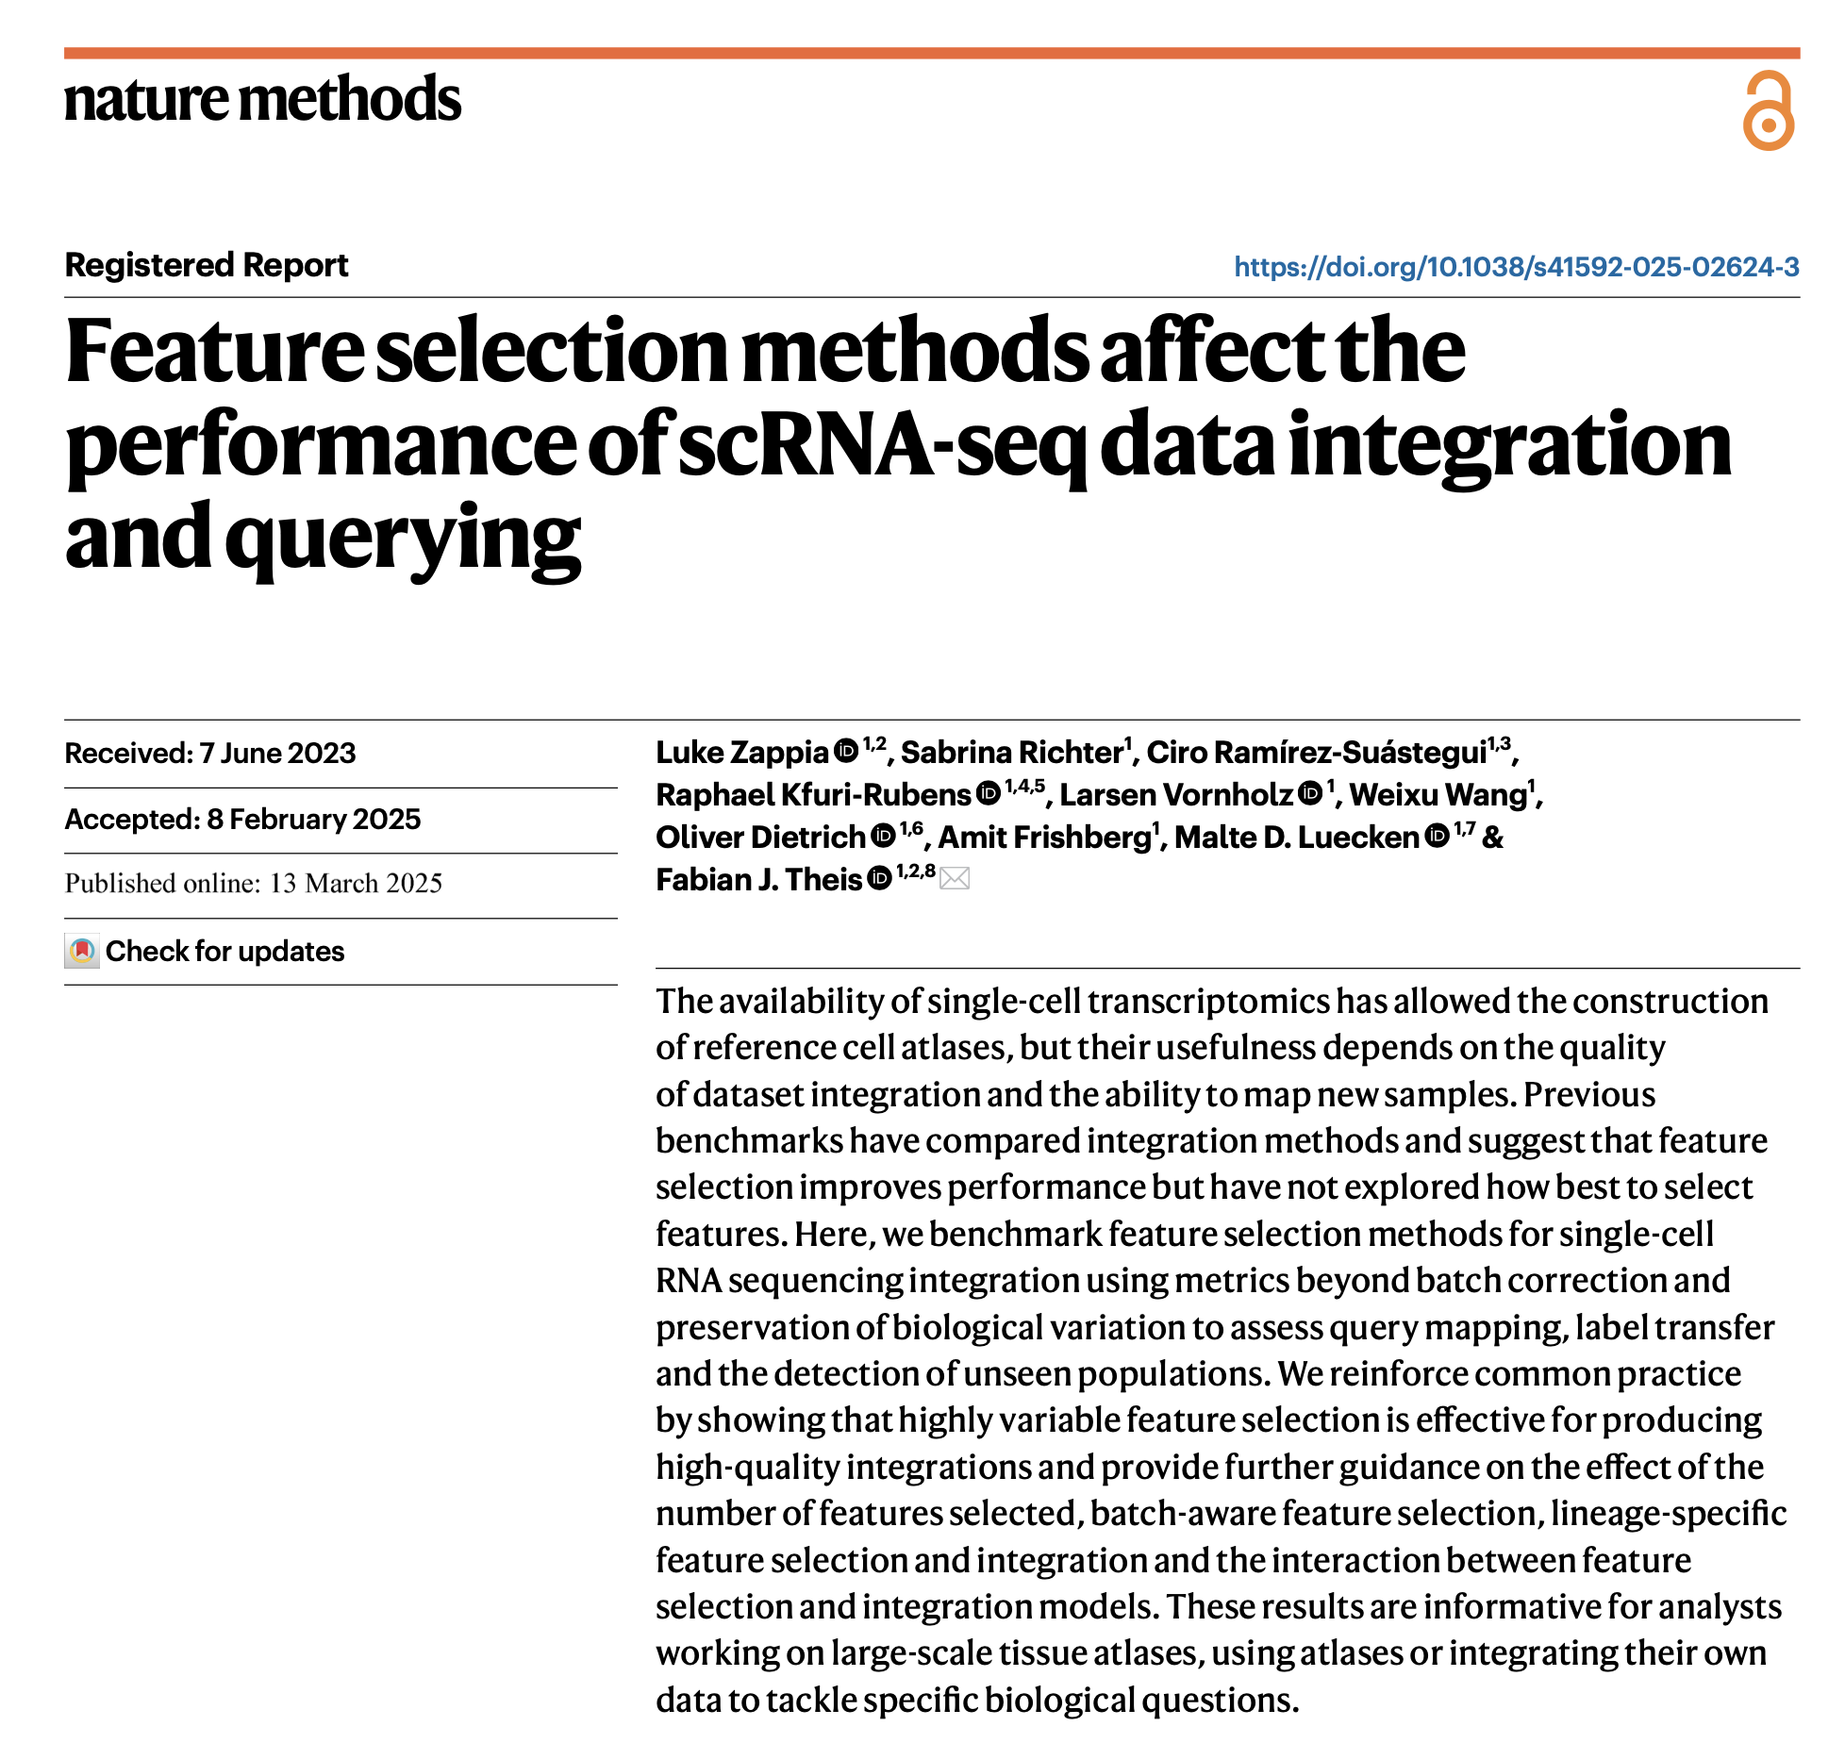
Journal club
4-1-2025
Ty Bottorff

Slide 2
Goal: assess the impact of feature selection method on integration/mapping
Previously shown that using highly variable genes generally leads to better integrations
Method of selecting these features hasn’t been considered in depth before
Important as all downstream steps rely on using a subset of features
Notes:
Previously shown line was from same group
Integration meaning batch correction
Assess the impact of feature selection method on integrating scRNAseq datasets/reference-query mapping

Slide 3
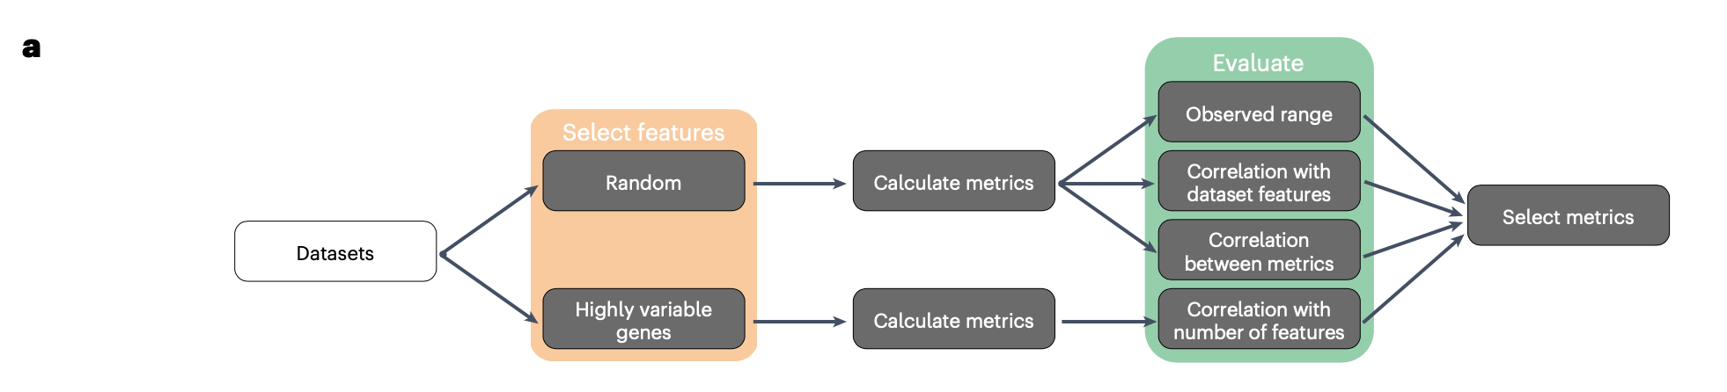
Workflow for choosing metrics to use for benchmarking integrations
Want nonredundant metrics that effectively measure integration performance, aren’t overly associated with technical factors

Slide 4
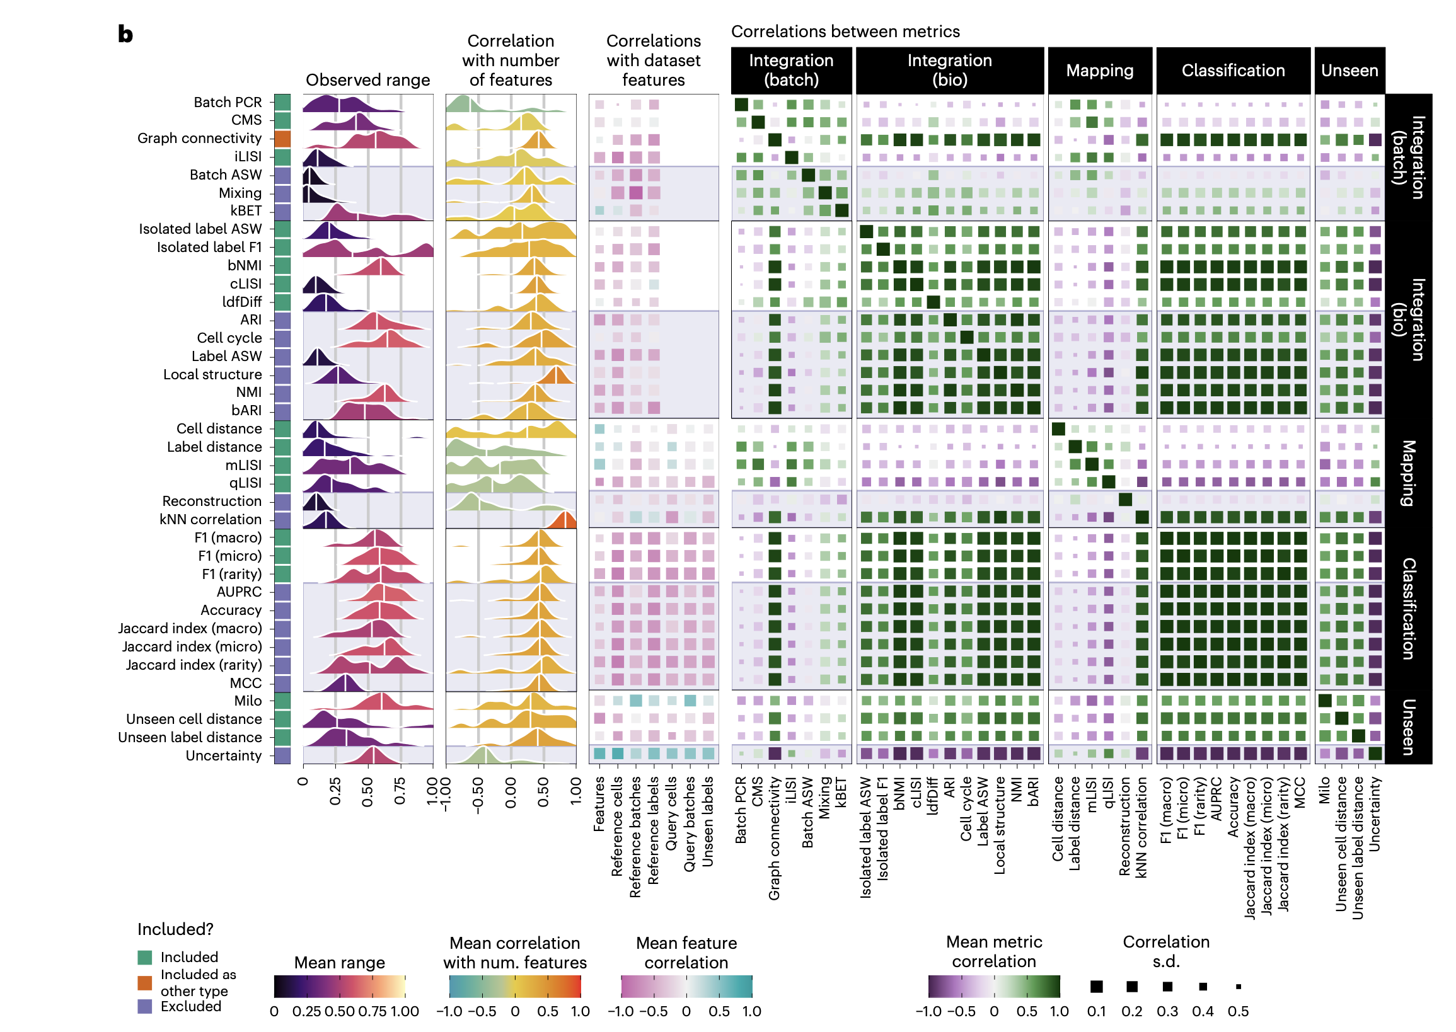
Choosing metrics to use for benchmarking integrations
*
*
*
*
*
*
*
*
*
*
*
*
*
*
Notes:
Evaluation metrics
We implemented a wide array of metrics designed to evaluate different aspects of creating and using an integrated scRNA-seq reference. Some metrics require a ground truth cell label, while others are unsupervised and measure whether the structure in a single sample is maintained. All metrics are designed so that a raw score of 0 represents the worst possible performance and a raw score of 1 the best possible performance.
Integration (Batch)
Integration (Batch) metrics measure the mixing between batches in the reference. Cells of the same cell type should be thoroughly mixed and neighborhoods should be equally likely to contain cells from any batch. The batch ASW³, Batch PCR³, graph connectivity³ and graph-based iLISI^{3,13} are implemented in scIB³ (v.1.1.4) using scikit-learn⁶⁰ (v.1.1.2). The kBET metric¹⁷ is accessed from the kBET R package (commit a10ffeaa) via scIB. To calculate an overall score for the Seurat mixing metric¹⁴ we divided the cell scores by the maximum neighborhood size, took the mean across cells and subtracted from 1 so higher scores are better. For the CMS metric¹⁸ in the CellMixS package (v.1.14.0) we use 1 minus the proportion of cells with a P value <0.1.
Integration (Bio)
Integration (Bio) metrics measure whether biological signals (primarily cell labels) are conserved after integration. Unlike batch correction metrics, where perfect scores can be obtained by mapping cells to a single point, biological conservation metrics require that cell labels are separated after integration. The label ASW³, graph-based cLISI^{3,13}, cell cycle conservation³, ARI³, NMI³, Isolated labels ASW³ and Isolated labels FI³ metrics are implemented in scIB using scikit-learn. bARI¹⁶ and bNMI metrics are available from balanced_clustering (commit a2ae3a4d). For the Seurat local structure metric¹⁴ we used the average over all cells as the final score and for ldfDiff¹⁸ we took the absolute distance and set an upper bound to get a cell score and used 1 minus the mean cell score as the overall score. The cell cycle metric³ scores cells¹¹ using genes from Tirosh et al.⁶¹ with ENSEMBL IDs obtained from Biomart⁶² using the biomaRt package⁶³. It cannot be calculated for the splat dataset as it does not contain cell cycle effects. For metrics that require clusters (ARI, NMI, bARI and bNMI), we performed Leiden clustering with the resolution parameter set to values between 0.1 and 2 in steps of 0.1 using scanpy via scIB and selected the resolution with the best metric score.
Mapping quality
Mapping quality metrics assesses how well the reference represents the query and is able to merge it into the same space. For perfect mapping, cell types present in both the reference and query should be mixed, as should batches within the query. At the same time, biology within the query should be preserved. The cell distance metric calculates the Mahalonobis distance between each mapped query cell and the distribution of the corresponding label in the reference¹². To create a bound for the distance we calculate the distance for every cell in the reference for a label and take the 90th quantile. The final score is 1 minus the proportion of mapped cells outside the boundary. The label distance considers labels as a whole rather than individual cells¹². The Mahalonobis distance is calculated between the centroid of the label in the query and the matching label in the reference. Labels are skipped if they have fewer than 20 cells in the query or are not in the reference. We used the maximum distance of query cells to their label centroid as a boundary. Distances to the matching reference label are then scaled using this value and set to 1 if they exceed the maximum distance. The final score is the mean across cell types.
mLISI is the same as iLISI but measures mixing between the query and reference (also known as ref_query LISI¹²) and qLISI measures mixing between query batches after mapping (also known as query_donors LISI¹²).
kNN correlation measures how well cell neighborhoods are maintained¹². For each query batch, a PCA is performed and the Euclidean distances to the 100 nearest neighbors of each cell are calculated. The distances to the same neighbors in the joint integrated embedding are also calculated and the Spearman correlation is computed. After adjusting the correlations to the range 0 to 1, the mean of cells in each batch is calculated and the final score is the mean across batches. For particularly bad integrations (that is small random feature sets), a cell may be equally distant from all neighbors, in which case the correlation cannot be calculated and it is assigned a score of 0.
The reconstruction metric assesses a generative model’s ability to represent query cells by sampling from the posterior distribution and measuring the cosine distance between the mean posterior expression profile and the true cell expression profile⁶⁴. We adjusted the distances to be in the range 0 to 1 and took 1 minus the mean distance as the final score. This metric cannot be calculated for Symphony integrations as it is not a generative method.
Classification
The classification (or label transfer) metrics measure how well a classifier trained on the reference can correctly predict labels for query cells. We use standard classification metrics: accuracy, F1 score, Jaccard index, Matthews correlation coefficient (adjusted to [0, 1]) and macro-averaged area under the precision-recall curve as implemented by scikit-learn. For F1 and the Jaccard index we use micro, macro and rarity-weighted¹⁹ averages over labels.
Unseen population prediction
Unseen population metrics focus on novel biology in the query by measuring how mapping has affected cell labels present in the query but deliberately left out of the reference. These should be maintained as separate populations but an integration that does not properly capture variation may merge them with other labels.
The unseen uncertainty metric uses the output of the label transfer classifier and measures poor classification of unseen cell by calculating 1 minus the mean probability of the assigned class for query cells from unseen populations. Unseen cell distance is based on the cell distance metric but calculated only for unseen query populations. As the label does not exist in the reference, we calculate distances to each cell’s nearest reference population and subtract the final score from 1 so that higher distances (greater separation from the reference) give higher scores. Unseen label distance applies similar changes to the label distance metric by calculating distances to the nearest reference label centroid.
We use the milopy⁶⁵ (commit be1a6cc8) implementation of the Milo differential abundance method¹⁵ as a metric to detect unseen populations by taking query or reference as the covariate of interest⁶⁴. A neighborhood graph is calculated in the integrated embedding using a number of neighbors equal to five times the number of batches (up to a maximum of 200). Milo is then applied to a subset of cells (up to 20,000 cells or 10% of the datasets, whichever is higher). The score for each label is the proportion of cell neighborhoods significantly associated with the query (false discovery rate-adjusted P value <0.1). The overall score is the average of the proportions across all unseen labels. In rare cases for poor integrations where Milo cannot select cells from an unseen label, that label is assigned a score of 0.
Most metrics positively correlate with number of features (> 0 for 2nd column), mapping metrics are generally negatively correlated though (maybe smaller feature sets produce noisier integrations, less-precise query mapping)
Want metrics that measure different aspects of integration/query mapping, so don’t want to select highly correlated metrics (would bias results), for example several metrics in integration (bio) category are correlated so only select 1 of those
Generally excluded metrics due to…
- limited (observed) effective range
- correlated with other metrics in same type
- inconsistent between datasets/can’t be calculated for simulated datasets (cell cycle)

Slide 5
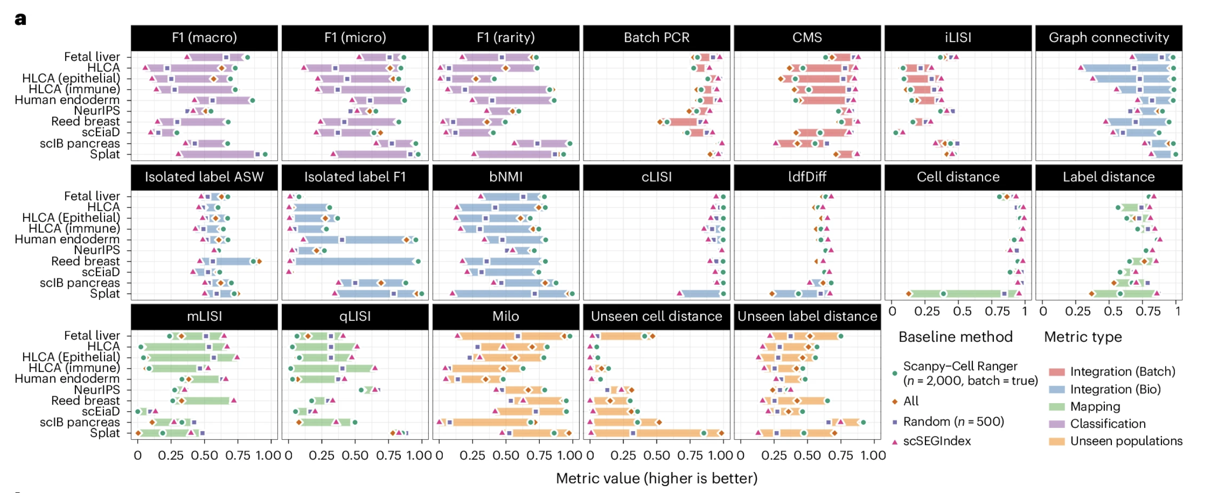
Establishing normal metric ranges to scale metric values
Notes:
Individual metrics have different effective ranges/interact differently with datasets, so need to adjust them to have same range for each dataset
Use 4 baseline methods (all features, 2k HVGs, 500 randomly selected genes, 200 stably expressed genes as negative controls that shouldn’t capture signal), integrate each dataset using features

Slide 6
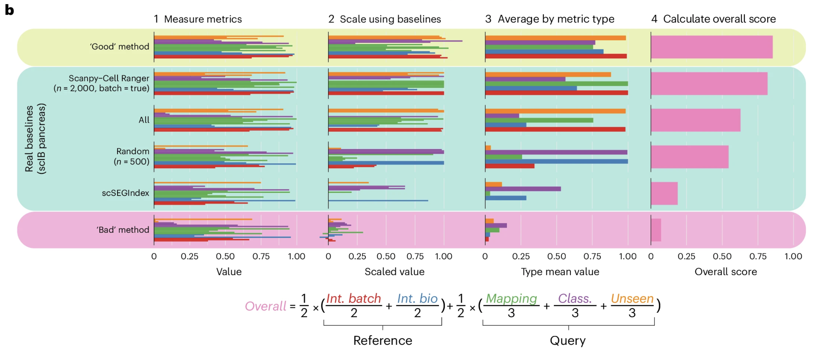
Notes:
We scaled the metric scores using the baseline ranges and aggregated them as shown in Fig. 2, using the scIB pancreas dataset³ as an example. This dataset was also used in stage 1 of the registered report. Along with the real baseline methods, we include theoretical ‘Good’ and ‘Bad’ methods that illustrate the behavior of methods that generally perform well or poorly across metric types (in contrast to the baselines, which each score highly on some metric types and lowly on others). The raw metric scores are scaled relative to the minimum and maximum baseline scores. After scaling, scores greater than one are possible if a method outperforms all the baselines (the ‘Good’ theoretical example) or negative scores are possible if a method performs worse than all baselines (the ‘Bad’ theoretical example). The interpretability of scores outside the reference range is an advantage of this scaling approach, providing additional context to the scaled values. We calculated summary scores for each metric type by taking the mean of the scaled values for that category. A final overall score is calculated as a weighted mean of category scores (Fig. 2b).
We chose this weighting scheme to give equal importance to integrating the reference and mapping of the query and, within those, equal consideration to the different metric types. While the overall scores are useful, we also present scores for each metric type in the following sections.
b, The process for scaling and aggregating metrics using the scIB pancreas dataset as an example. The real baseline methods and theoretical ‘Good’ and ‘Bad’ methods are shown. First, the metrics are measured, and then the values are scaled using the baseline ranges. Scaled values greater than one or less than zero are possible if a method performs better or worse than the baselines. Average scores for each metric type are computed, and the overall score is calculated as a weighted average of the category scores using the equation below

Slide 7
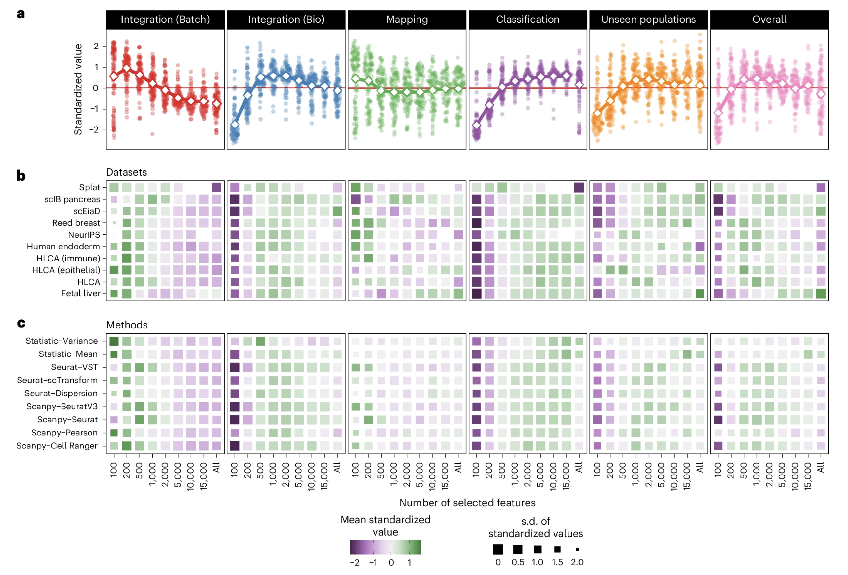
Effect of the number of selected features
Notes:
Default # HVGs typically 2000
3a y-axis are Z-scores for each dataset and method combination
Integration (batch) score highest for small feature sets, similar but less extreme for mapping (converges to mean with 500 features)
Classification/unseen pops show opposite trend (low # features bad, more better but just > 500 is sufficient really)
Integration (bio) bad with low # features, good with mid range, little worse with many more
Patterns reflect that better batch correction comes at expense of creating ”noisy” integrated embedding with less separation b/w cell types (so lower bio integration?)
There is variation depending on the dataset/method in these results but there are some variations, like simulated splat dataset needing less features to capture variation but scIB pancreas dataset needing more given real data complexity and has several technologies that present integration challenge
# of features at which additional signal saturates varies by dataset (function of biological/technical diversity)
They used 2000 features going forward (produced high scores across datasets, except for several methods that use less features

Slide 8
Types of feature selection methods
Notes:
Simple control methods
We include all features and random feature sets in the evaluation as control methods. We expect that using feature sets selected by real methods improves performance over using all features and any randomly selected sets. To control for variability in selecting random features, we always include five random feature sets selected with different seeds and average metric scores over the five sets.
Excess variability methods
The most common approach to feature selection in RNA-seq analysis tool boxes such as scanpy¹⁰ and Seurat¹¹ is to select highly variable features, those that show excess variability beyond what is expected. This approach assumes that extra variability results from differences in gene expression between cell populations or states and that selecting these features will identify those important to the cells in the sample.
We benchmark the following excess variability methods: features with the highest variance, the fitting method from Brennecke et al.³⁸ (implemented in scran⁵³ v.1.26.0), variants from Seurat¹¹ (v.4.3.0) (Seurat-dispersion, Seurat-MVP¹¹ and Seurat-VST²⁵), variants from scanpy¹⁰(v.1.9.1) (scanpy-Seurat, scanpy-SeuratV3 and scanpy-Cell Ranger) and the approach from ‘Orchestrating Single-Cell Analysis with Bioconductor’³⁵ using batchelor⁵⁴ (v.1.14.0) and scran. For scanpy methods we used both standard and batch-aware variants.
Methods based on other statistical features
Other feature statistics can also be used for feature selection including selecting features with the highest mean expression, Anticor²⁷ (v.0.1.8), which selects features with excess negative correlations, NBumi which selects features with excess zeros (M3Drop v.1.24.0)²⁹ and DUBStepR (commit 76aa3948), which uses stepwise regression of a binned correlation matrix²⁸.
For Anticor, we disabled the filtering of predefined gene pathways as it requires gene identifiers, which are not available for all datasets. For NBumi, we select features with an adjusted P value <0.01 unless this results in fewer than 500 features, in which case the 500 features with the lowest P values were used.
Model-based methods
Model-based methods fit an appropriate distributional model to the dataset. Features are then selected by looking for those significantly different from the fitted model. These include scTransform⁵⁵ (v.0.3.5, accessed via Seurat), analytic Pearson residuals⁵⁶ (implemented in scanpy) and scry (v.1.10.0)⁵⁷.
Model-based methods
Model-based methods fit an appropriate distributional model to the dataset. Features are then selected by looking for those significantly different from the fitted model. These include scTransform⁵⁵ (v.0.3.5, accessed via Seurat), analytic Pearson residuals⁵⁶ (implemented in scanpy) and scry (v.1.10.0)⁵⁷.
Embedding-based methods
Dimensionality reduction is a commonly used preprocessing step in scRNA-seq analysis. Some feature selection methods either use sophisticated embedding methods or look for features that vary across an embedding. scPNMF (commit 47d5b10c) performs a modified PNMF, where an alternative initialization is used and selects features associated with informative bases³¹, and singleCellHaystack (v.0.3.4) uses Kullback-Leibler divergence to find features that are expressed in subsets of nonrandomly positioned cells³⁶. For singleCellHaystack, we first select features using Seurat-VST and perform a 50-dimensional PCA as input.
Graph-based methods
Another common step in scRNA-seq analysis is to build a nearest-neighbor graph of cells, typically using positions in an embedded space. Some methods operate on these graphs. Hotspot (v.1.0.0) looks for features with a high local auto-correlation within a graph⁵⁸ and triku (v.2.1.4) uses a neighborhood graph to distinguish features that are expressed in a few cells randomly across a dataset from those that are expressed in a few related cells³⁰. For both, we use a graph based on a PCA of all features as input.
Supervised methods
We focus on evaluating unsupervised feature selection methods, as cell labels are typically not available before the integration process; however, at least some level of cell labels may be available, particularly for atlas-building projects that combine previously annotated public datasets. As an example supervised method, we include marker genes selected using the Wilcoxon rank-sum test (as implemented in scanpy) followed by a filtering procedure to remove features expressed in less than 10% of cells within a label, expressed in more than 80% of cells outside the label or with a P value >0.1. The remaining features are sorted by estimated log fold change and the top 200 features are selected per label. The final feature set is the intersection of the features selected for each label.
We also included known transcription factors downloaded from The Human Transcription Factors⁵⁹ website (https://humantfs.ccbr.utoronto.ca/index.php) selecting 1,639 genes where the ‘Is TF?’ field was equal to ‘Yes’. The intersection of this list with the genes in each dataset was used. This method cannot be applied to the splat dataset as it does not contain real gene names.
Stable expression methods
The opposite of highly variable features are those stably expressed or varying less than expected. The scSEGIndex method in the scMerge package (v.1.1.4.0) fits a gamma-Gaussian mixture model to each feature²³. The parameters of this model and other features, such as the proportion of zero counts, are used to rank features and calculate a stability index. We used these stable features as a negative control and they should perform poorly for integration as they should not capture either technical noise or biological signal.

Slide 9
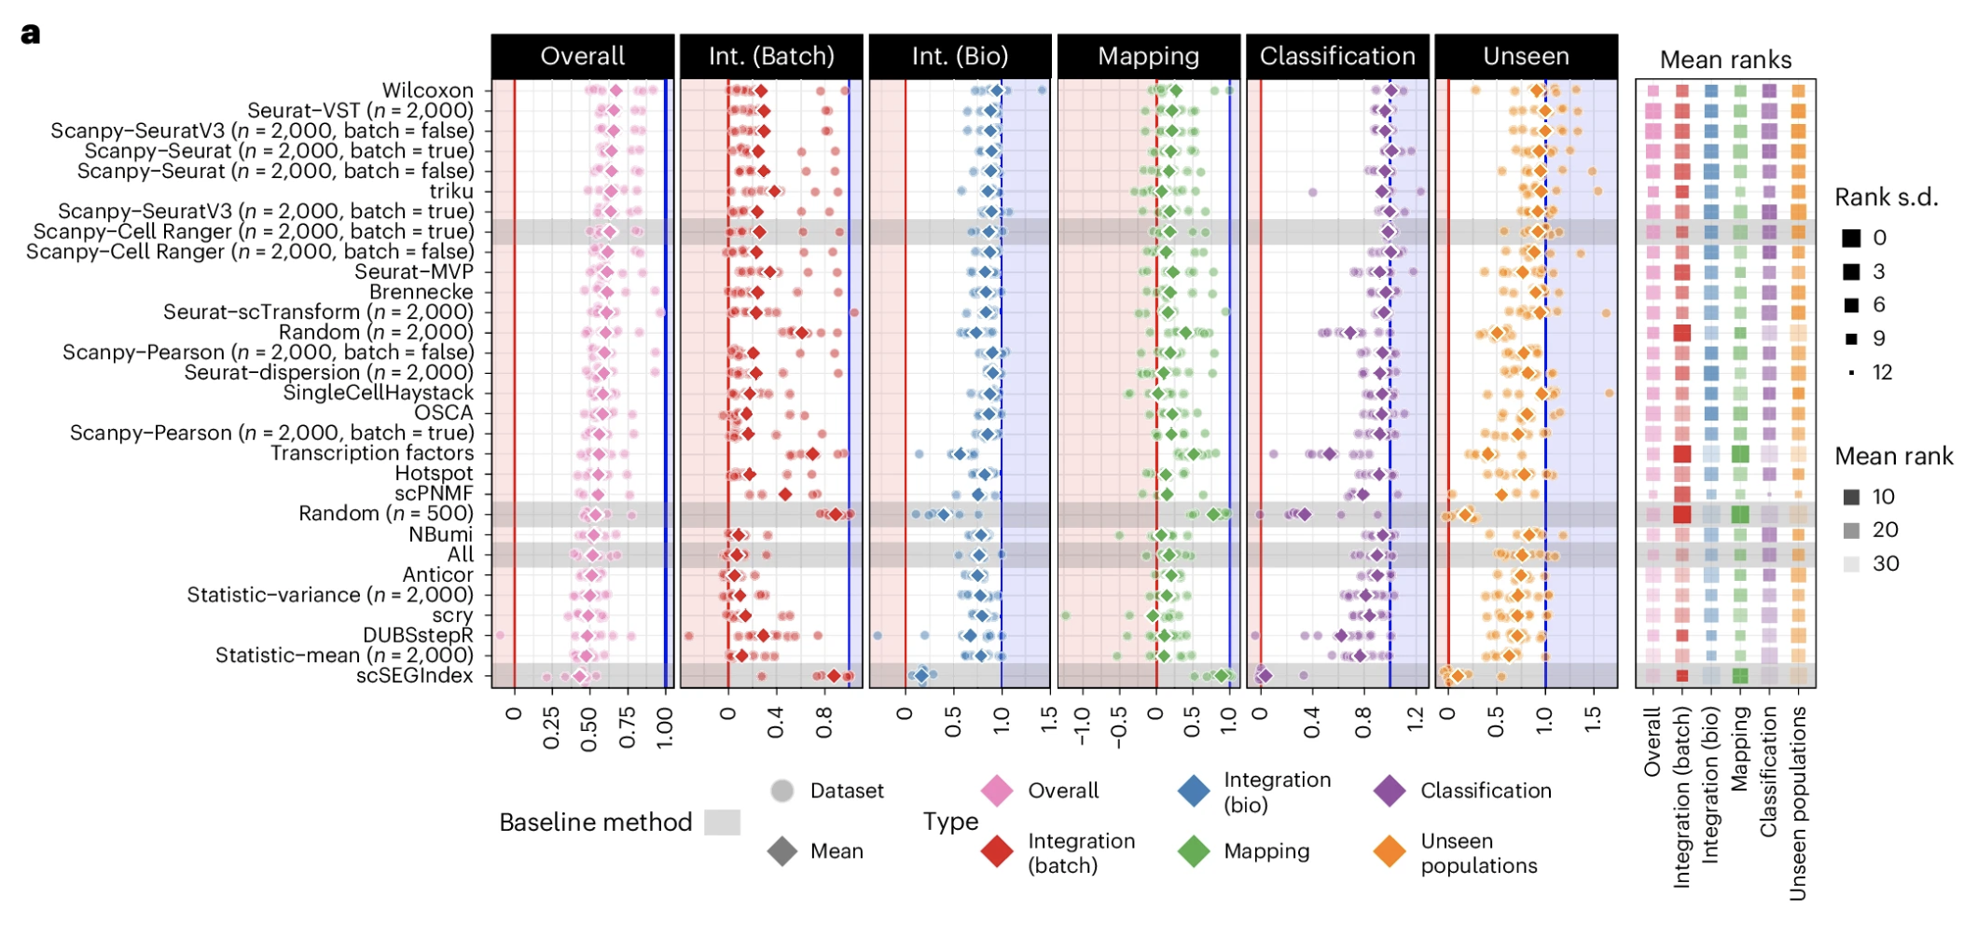
Summary of method performances by metric type
Notes:
takes a dataset, applies standard preprocessing and splits it into reference and query samples. The feature selection methods are applied to the reference, and selected features used for integration. After integration, the query is mapped to the reference, and a cell label classifier is trained. The reference and query, ground truth cell labels and transferred labels are provided to metrics. The metric scores are then scaled, aggregated and ranked.
Points show scores for individual datasets and diamonds show the mean values
Methods are sorted by mean overall score, and baseline methods are indicated by gray shading. Shaded areas show scores less than (red) or greater than (blue) the baseline range (0–1). Average rankings for each metric type are shown on the right, with color indicating mean rank and size s.d. (smaller is more variable)
Figure 4a shows the overall results for each metric category, sorted by the mean overall score across datasets for scVI integration (Extended Data Fig. 5a). Several methods obtain similar average overall scores. The Wilcoxon method, the only method to select features using cell labels, has the highest average overall score but is more variable across datasets than other top-performing methods. This higher variability suggests that supervised selection of features may not be effective for all datasets, even when the same labels are used for evaluation, and that tuning the number of features selected using this approach could be required. The Seurat-VST method obtains the highest overall ranking and several other highly variable feature selection methods also perform well with similar mean scores and more consistent performance than Wilcoxon. The other top-performing alternative method is triku, which has similar overall scores to the highly variable selection methods but shows some bias toward batch correction over conserving biological variation.
The lower-ranked methods show more variation in scores for individual categories (Extended Data Fig. 5). In particular, the baseline random and scSEGIndex methods score very highly on the Integration (Batch) and mapping categories but poorly on the categories measuring biological information. This effect demonstrates that it is easy to obtain good mixing between batches by selecting features that only contain noise and the importance of including metrics that measure the conservation of biological variation. Using a predefined list of transcription factors also produces a bias toward batch correction, demonstrating that it is not sufficient for features to be biologically important but that they must also be relevant to particular datasets. Transcription factors are typically lowly expressed and therefore noisy. Although the effect is less pronounced, some methods, such as OSCA³⁵ and singleCellHaystack³⁶, rank highly on Integration (Bio) but not on batch correction, with singleCellHaystack also scoring similarly to the top methods on unseen population detection. The singleCellHaystack method uses Seurat-VST as a preprocessing step to create a principal-component analysis (PCA) space where the final features are selected but these additional steps do not lead to better performance than Seurat-VST alone.

Slide 10
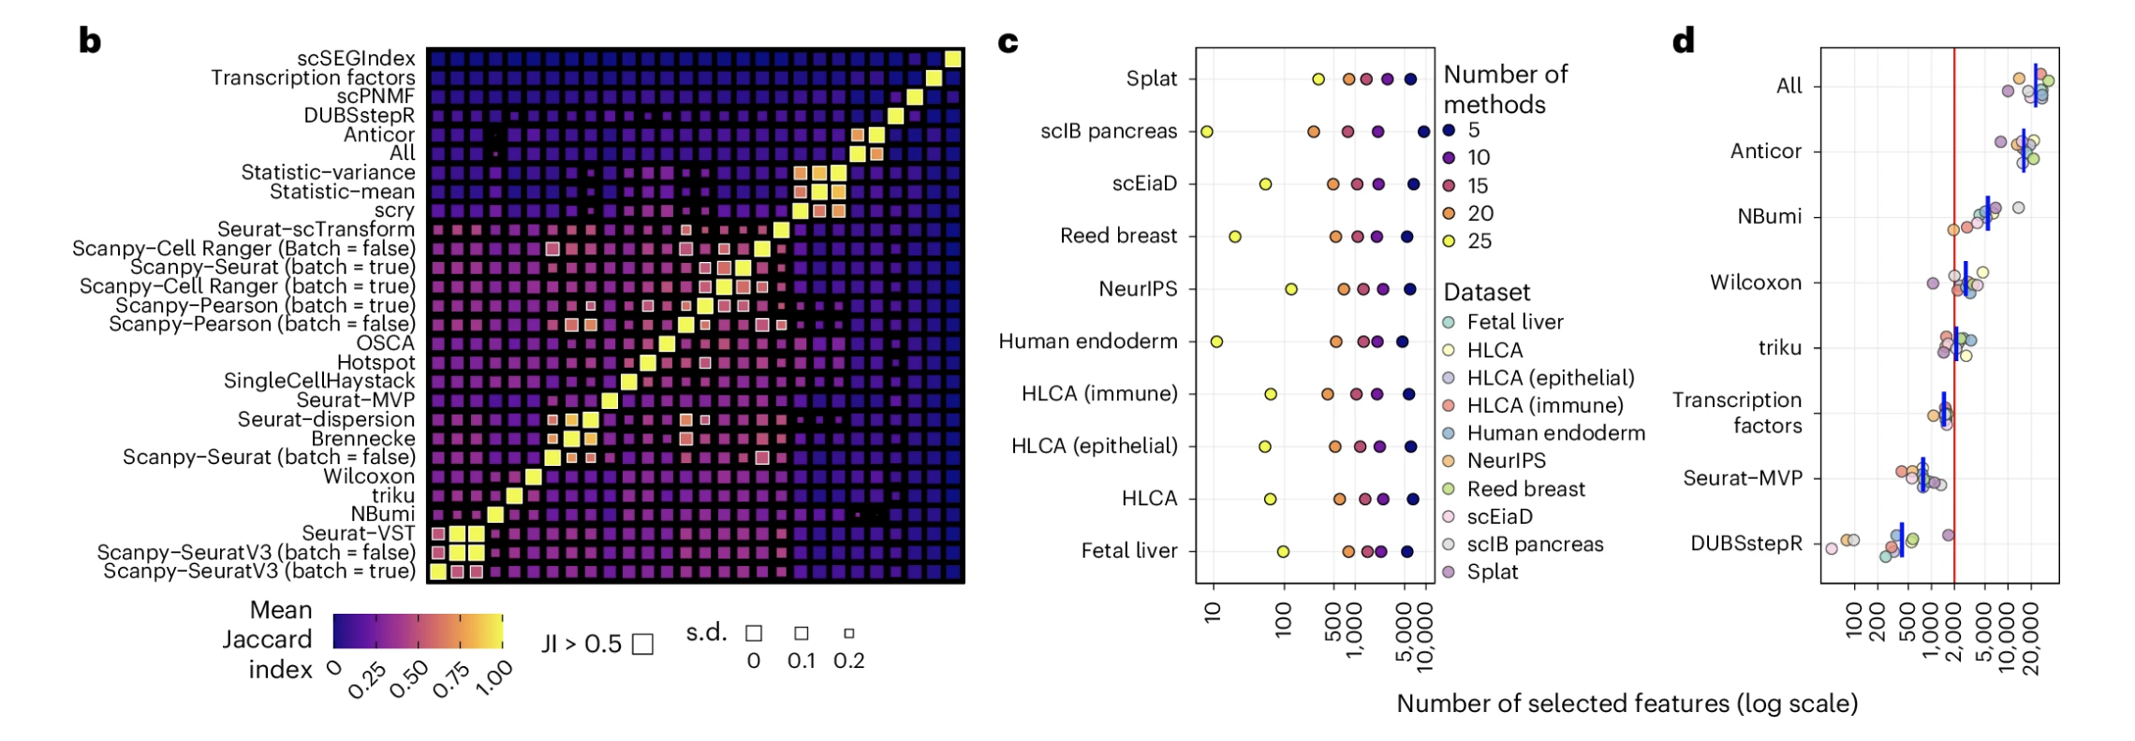
Overlap of features selected by different methods
Notes:
B) Overlap of features selected by different methods. The heatmap shows the mean Jaccard index (JI) between feature sets selected by different methods (excluding random gene sets)
C) The number of features (on a log₁₀ scale) selected by at least n methods (n = 25, 20, 15, 10 and 5) for each dataset. Colors indicate the number of methods.
D) The number of features selected by different methods. Points are colored by dataset, and blue bars show the mean for each method. Only methods which automatically determine the number of features are shown. Most other methods were set to select 2,000 features, as indicated by the red line, except scPNMF, which uses 200 features.
We see some overlap in selected features for most methods, but there are very few combinations where the mean Jaccard index is above 0.5 (Fig. 4b and Extended Data Fig. 6). One pair that stands out is Seurat-VST and scanpy-SeuratV3, which produce identical sets. This overlap is unsurprising, given that they are different implementations of the same method, but it is reassuring to see consistency between packages using different programming languages. As the selected features are identical, any differences in performance we see between these methods results from randomness in integration or metrics. The scanpy-Seurat and Seurat-MVP methods also implement the same approach but the scanpy implementation allows specifying the number of features, while the Seurat implementation selects the number of features dynamically using a threshold. There are also some differences in preprocessing steps, contributing to their lack of consistency.
Despite the lack of high overlap between selected feature sets, we still see a core set of features selected by most methods, with between 500 and 1,000 features being selected by at least 20 methods for most datasets (Fig. 4c). This consistency suggests that a subset of features clearly contains information for a dataset and should be crucial for effective integration and query mapping. That the remaining selected features are less likely to be shared between methods that have similar performance may result from redundancy in gene expression, with several genes carrying information about the same biological processes.
The number of features selected by dynamic methods (Fig. 4d) can also be related to performance. The Anticor method selects the majority of features in each dataset and, therefore, performs similarly to using all features. DUBStepR uses the most complex procedure of the methods compared here, resulting in very few selected features and low overall performance. However, DUBStepR scores relatively highly on biological metrics, suggesting that the features it selects are informative but insufficient to correct batch effects. The dynamic methods that perform well (Wilcoxon, triku and Seurat-MVP) select a number of features closer to the 2,000 features we chose to use for most methods. Seurat-MVP selects fewer than 2,000 features for all datasets and in comparison to scanpy-Seurat, which uses the same algorithm but is set to 2,000 features, Seurat-MVP has higher Integration (Batch) scores but similar Integration (Bio) performance. While fewer features are adequate for integrating the reference, the additional features included by scanpy-Seurat improve query classification and unseen population detection.
Feature selection can also be employed in a batch-aware fashion by selecting features for individual batches and combining the results, typically by choosing the features selected for the most batches. The intuition behind this approach is that it avoids selecting features that vary between batches but not between biological states within a batch. To assess the effectiveness of this approach, we included batch-aware variants of the scanpy methods. Figure 4e shows the difference in performance for each dataset and metric type compared to standard selection. We see significant differences in the summary scores for some scenarios, but this effect is inconsistent across either datasets or metric types, and the differences in the overall score are relatively small. For example, batch-aware selection improves the unseen population score for the HLCA (Immune) dataset but is significantly worse for the HLCA (Epithelial), Human endoderm and scIB pancreas datasets. The OSCA method also selects features in a batch-aware way but does not rank among the top-performing methods. While we do not rule out batch-aware feature selection as a useful approach, we cannot identify a scenario where it is consistently more effective than selecting features across batches.

Slide 11
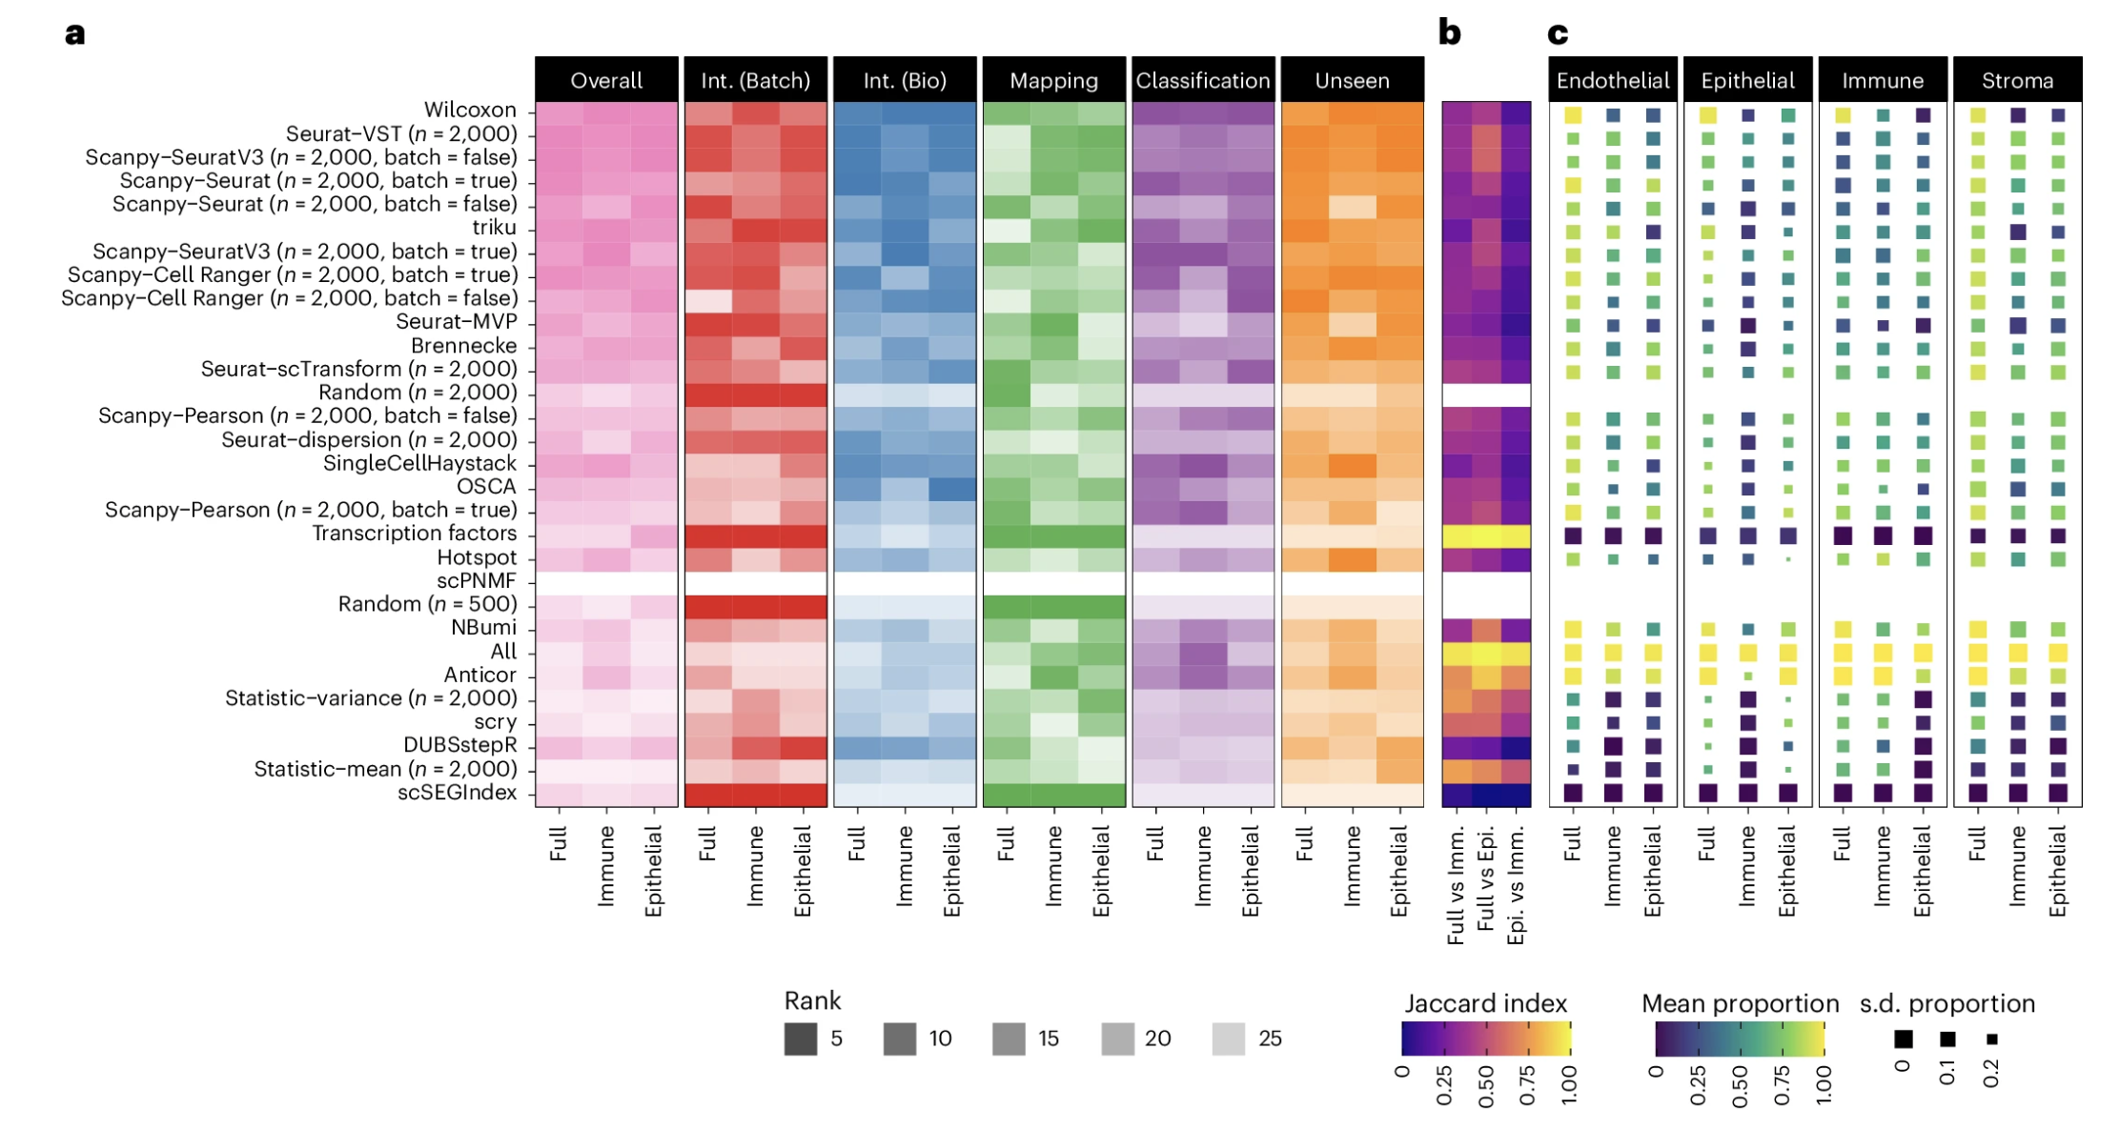
Lineage-specific feature selection and integration
Notes:
An open question in large-scale integration projects is whether to integrate across the full diversity of cell states or to limit the complexity by subsetting to specific lineages or conditions. While we cannot fully address this question here, we can investigate some aspects by considering the three versions of the HLCA dataset.
Figure 5a shows the rankings for all methods for each HLCA subset, including the overall ranking and the ranking for each metric type. In general, these follow the trends we observed when considering all datasets, and we do not see any methods that consistently rank higher on the lineage subsets compared to the full dataset. To see whether the similar rankings across subsets resulted from selecting similar feature sets, we computed the Jaccard index between selected features (Fig. 5b). While there is some similarity in feature sets, the overlap is not higher than we saw between all datasets. The Jaccard index tends to be lower for higher-ranking methods, suggesting that these methods can successfully adapt to each dataset. We also see that the overlap in selected features between the immune and epithelial subsets is less than with the full dataset.
One motivation for lineage-specific feature selection is that it results in selecting more specific features for the cell types in that subset. To test this, we considered the published marker gene sets for the HLCA and calculated the proportion of these markers selected by each method on each dataset subset. Figure 5c and Extended Data Fig. 7 show the mean proportion of selected markers across cell types for each lineage in the full HLCA (endothelial, epithelial, immune and stroma). In most cases, relatively few calculated markers are selected (proportion of markers mean, 0.38; median, 0.39; and first quartile, 0.04) (Extended Data Fig. 7). The lack of markers chosen may be due to redundancy in the information contained by related genes and differences in which features are prioritized for selection compared to marker detection. Selectivity of the markers chosen was not related to performance, with some of the worst-performing methods most effectively selecting markers only for the cell types in a specific lineage (Extended Data Fig. 7).
a, Method rankings for the full HLCA dataset, the immune subset and the epithelial subset. Overall rankings are shown, along with rankings for each metric category. Methods are ordered by their overall performance across all datasets. b, Overlap of selected feature sets. The Jaccard index values between feature sets from each subset are shown as a heatmap. c, Overlap with marker genes. A heatmap of the mean proportion of marker genes selected by each method on each dataset subset. The mean is calculated for each lineage in the full dataset (endothelial, epithelial, immune and stroma). The size of squares shows the s.d. of proportion across cell types in each lineage (smaller is more variable) (Extended Data Fig. 7). Overlaps are not shown for random gene sets.

Slide 12
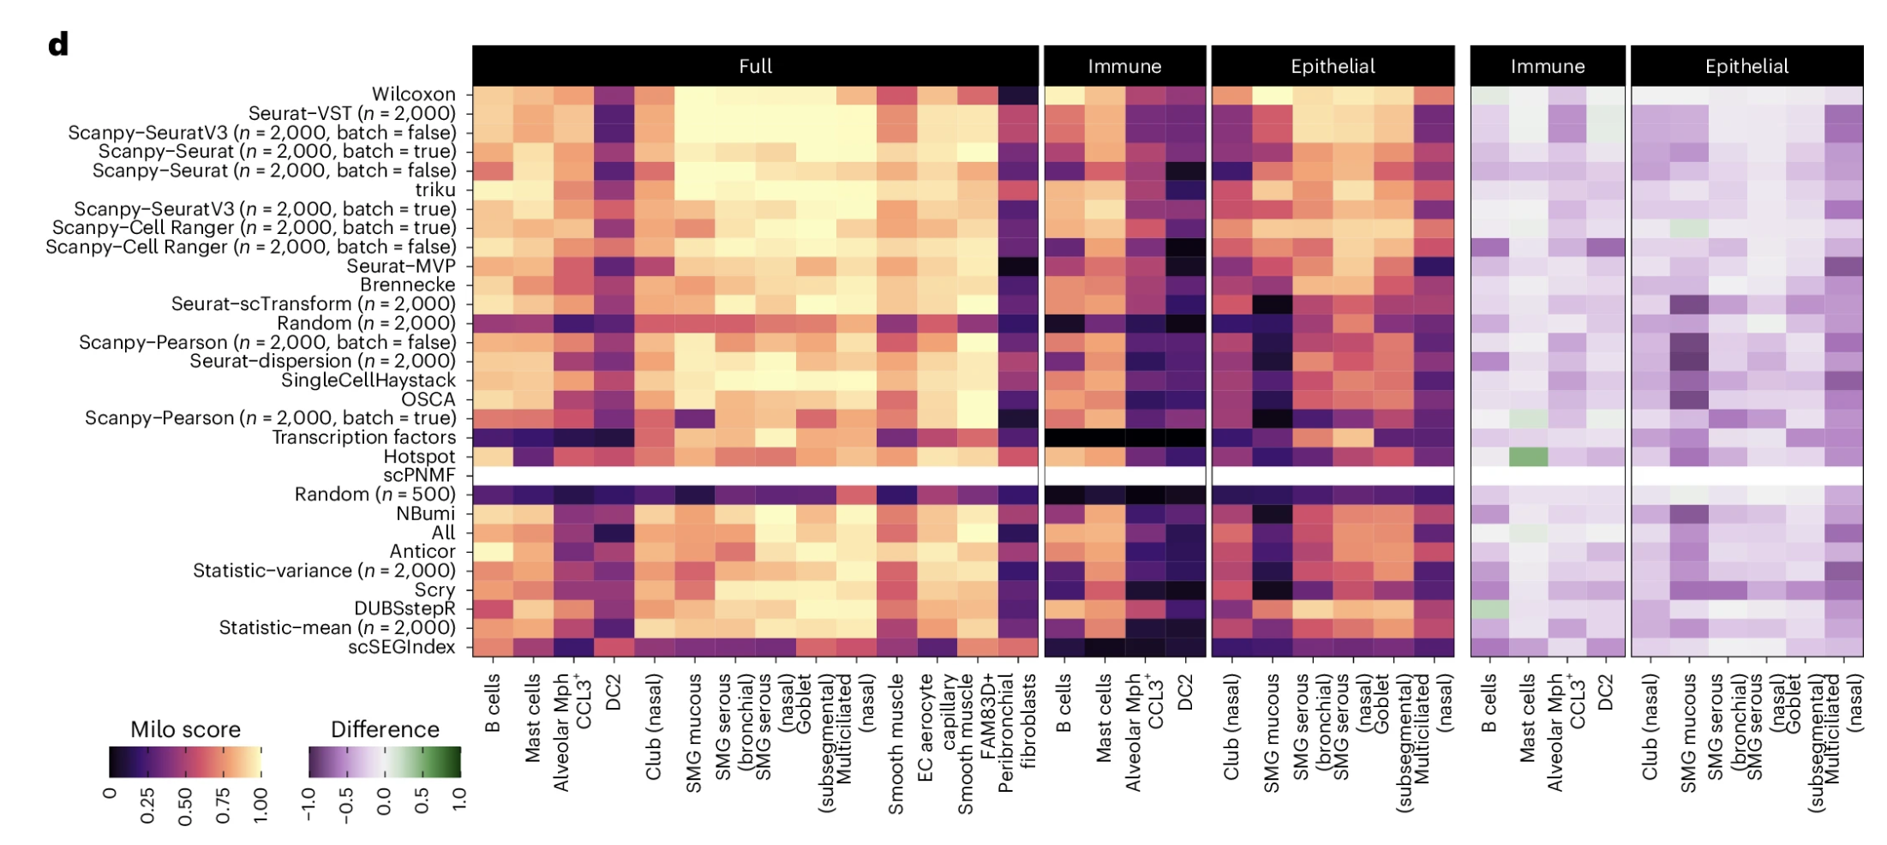
Lineage-specific feature selection and integration
Notes:
So far, we only considered the ranks of methods because individual scores are not directly comparable between subsets as they contain different cells and labels. To consider one area in more detail, we calculated Milo scores for individual unseen labels, allowing us to see if an unseen cell type is easier to distinguish in a whole-tissue or lineage-specific atlas (Fig. 5d). We see a clear trend of lower scores on the lineage subsets. This pattern supports the argument that by providing more diverse input data to the integration model it learns more of the possible cell space and can, therefore, better distinguish new cell populations.
Analysis of cell label Milo scores. A heatmap shows the Milo score for each unseen cell type on the full, immune and epithelial subsets. On the right is shown the difference in scores for each lineage subset compared to the full dataset.

Slide 13
Takeaways
Highly variable genes still best general approach for feature selection
Marker-based selection may be worth it if you have prior knowledge (well-defined cell types w/ good markers)
Seurat-VST/scanpy-SeuratV3 top-ranked method
Multiple “good” feature sets exist for a dataset, low overlap b/w feature sets b/w similarly performing methods
~2,000 features gives high integration and query performance
< 500 may improve batch correction but hurts preservation of biological signal
> 5,000 may even reduce query performance
> 2,000 may be needed to detect unseen populations in query datasets
Optimal number of features will vary with dataset/goal
Best feature selection methods work across integration methods
Selecting features separately per batch then merging is not recommended (didn’t improve performance and often made performance worse)
If there are strong batch effects, focus on good integration rather than changes to feature selection
Lineage-specific feature selections also don’t show benefit (integrating all lineages is better, more diverse reference improves query selection)
Notes:
We encourage analysts to tune the number of selected features for their dataset and use case and we believe this will affect performance more than switching between top-performing methods
reinforces common practice and recommendations from previous benchmarks
Label-guided marker genes (Wilcoxon) also performed well but were more variable across datasets
triku method was also highly ranked but showed some bias toward batch correction
We focused on unsupervised methods and other supervised techniques may produce more stable results; however, supervised feature selection only applies when cell labels are available, typically not the case before integration
We did not find a consistent advantage for batch-aware variants of methods implemented in scanpy. Batch-aware selection could improve performance in some scenarios, but a more specific evaluation including additional methods is required to determine its applicability. For large datasets, batch-aware feature selection has a computational advantage, as loading the whole dataset into memory can be avoided. However, we could run many top-performing methods on the full datasets with relatively modest memory requirements
Using subsets of the HLCA dataset, we considered lineage-specific feature selection. We did not see any clear preference for methods and particular lineages, and the top-performing methods effectively adapted to different subsets. Milo scores for individual unseen labels showed that it is easier to distinguish new cell populations using a more diverse reference atlas; however, this comparison was not our primary focus, and further work is required to determine if or when lineage-specific features selection and integration can be effective. For example, we did not consider whether lineage-specific features could improve integration of the full dataset or attempt to disentangle effects of feature selection from integration.

Slide 14
Concerns brought up in peer review
Should vary number of features w/ same method of feature selection
“optimal” feature set may vary depending on cell types/tissues present as well as on sequencing technology, should use established atlases to ask how cell type/tissue affects what optimal features are
Need to know ground truth for evaluating metrics, so should use simulated datasets where ground truth is known
How many random feature sets were chosen as a null? Random feature set should be matched for gene expression distributions, sequence-ability to be a fair null comparison
Focus too much on droplet-based chemistry (especially as publicly available data for meta analyses aren’t all droplet-based)

Slide 15
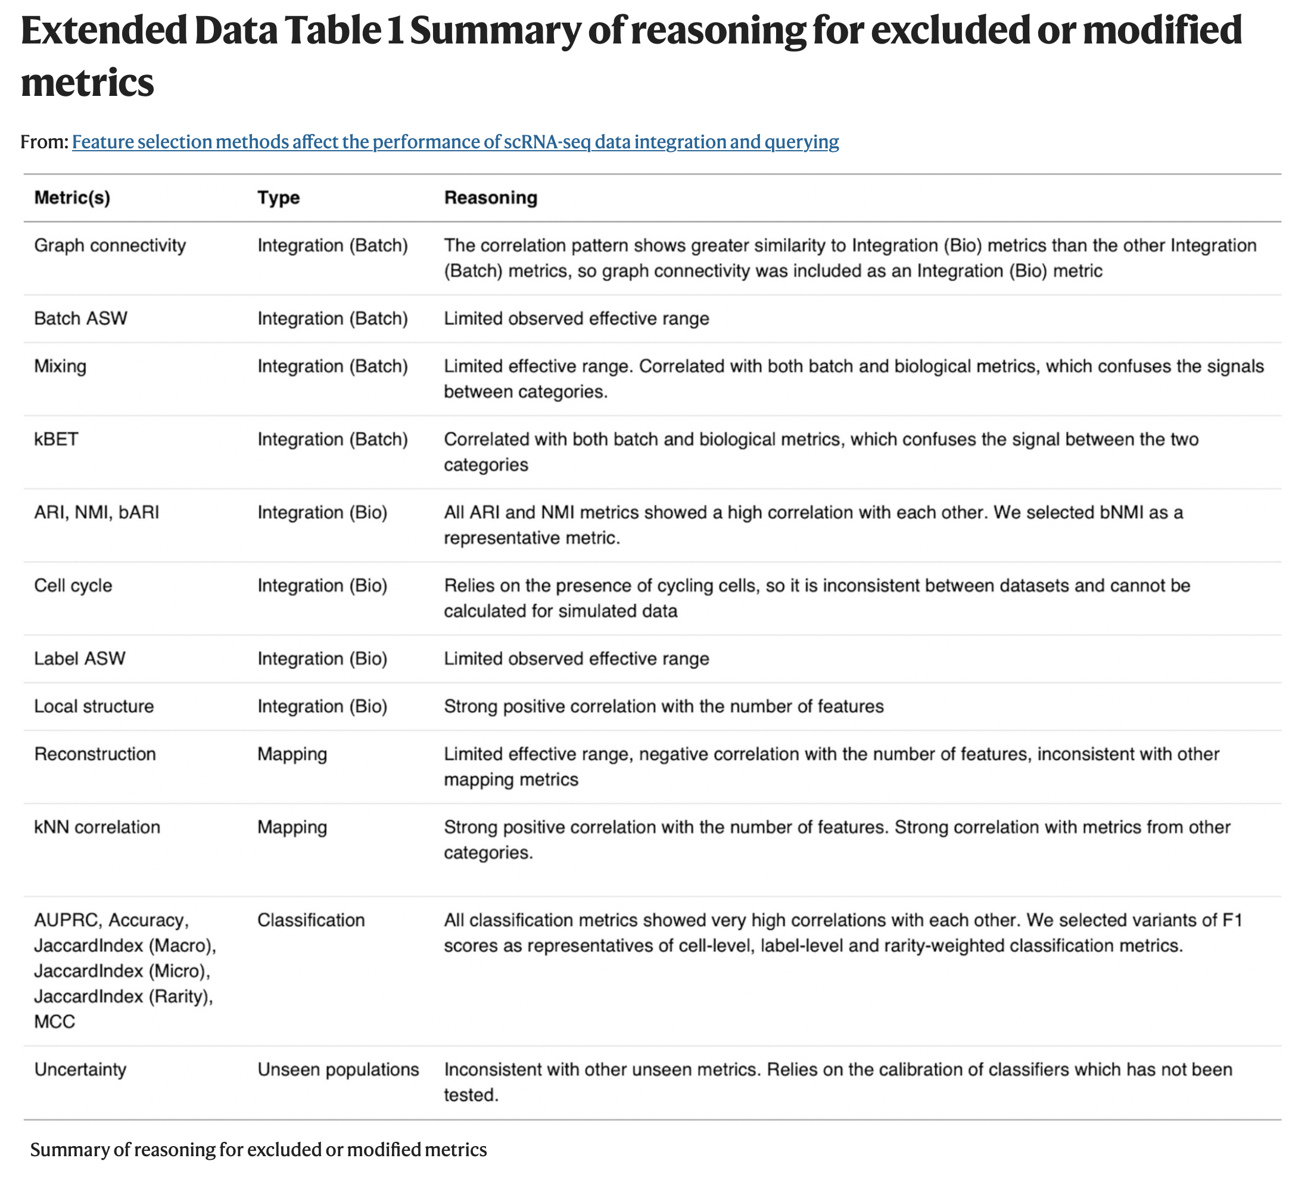
Reasons for excluding metrics

Slide 16
Datasets analyzed
Notes:
Benchmarking datasets
We selected datasets representing different scenarios (tissues, technologies and developmental stages) where integration is a critical analysis step, including smaller-scale datasets and larger atlases. We chose query batches by selecting batches with shared characteristics different from the remaining samples, such as technology, time point or location. The unseen populations removed from the reference were chosen by looking for labels enriched in the query batches and selecting labels presenting different challenges, such as rare or perturbed cells. For each dataset, we use the cell labels assigned by the original authors.
scIB Pancreas
We downloaded the scIB pancreas dataset³ from figshare⁶⁶. Cell labels were taken from the ‘celltype’ cell annotation column (12 reference labels) and batches from the ‘tech’ column. For the query, we used batches representing the CEL-seq and CEL-seq2 technologies with the ‘activated_stellate’ label treated as an unseen population. The prepared dataset contained 18,319 features, 12,731 reference cells (seven batches) and 3,243 query cells (two batches).
NeurIPS 2021
We downloaded the NeurIPS 2021 CITE-seq dataset^{67,68} from the Gene Expression Omnibus (GEO)⁶⁹ (GSE194122) and used only the gene expression features. Cell labels were taken from the ‘cell_type’ annotation and batch labels from the ‘batch’ annotation. We considered samples from Site 4 as the query with the ‘CD8⁺ T naive’ and ‘Proerythroblast’ labels treated as unseen query populations. After preparation, the dataset contained 13,953 features, 70,061 reference cells (nine batches) with 42 reference labels and 16,715 query cells (three batches).
Fetal liver hematopoiesis
We downloaded the fetal liver hematopoiesis⁷⁰ dataset from CellAtlas.io⁷¹ using batch labels from the ‘fetal.ids’ annotation and cell labels from the ‘cell.ids’ annotation. Three samples from different developmental stages were treated as the query with ‘Kupffer Cell’, ‘NK’, ‘ILC precursor’ and ‘Early lymphoid_T lymphocyte’ as unseen populations. The prepared dataset contains 26,686 features, 62,384 reference cells (11 batches and 23 reference labels) and 26,449 query cells (three batches).
Reed breast
We downloaded the version of the Reed breast dataset³² released with the preprint⁷² from the Chan Zuckerberg CELLxGENE: Discover Census (https://cellxgene.cziscience.com/)⁷³(dataset ID 0ba636a1-4754-4786-a8be-7ab3cf760fd6, Census version 2023-07-05) using the cellxgene-census package (v.1.0.1) and subsetted to cells with a BRCA status of either wild-type (‘WT’ or ‘assumed_WT’) or ‘BRCA1’. Donor ID was used as the batch label, with cell labels taken from the ‘level2’ annotation. We excluded a subset of cells labeled as doublets, as it is not clear how they should be treated by metrics. Wild-type cells were used to create the reference and BRCA1 cells were used as the query. The ‘BSL2’, ‘CD8T 1’, ‘CD8T 2’, ‘CD8T 3’, ‘FB5’, ‘LEC1’ and ‘LEC2’ labels were used as unseen labels. After preparation, the dataset contained 33,691 features, 337,339 reference cells (24 batches and 32 reference labels) and 197,649 query cells (17 batches).
Single-cell Eye in a Disk
We downloaded the single-cell Eye in a Disk (scEiaD) dataset⁷⁴ from the plae: PLatform for Analysis of scEiad website (https://plae.nei.nih.gov/) and selected the human cells derived from tissue samples where the organ was specified as ‘Eye’. We removed cells that did not have a cell label or were labeled as doublets and batches with fewer than 500 cells remaining, as these caused some metrics to produce unreliable results. Cell labels were taken from the ‘CellType_predict’ annotation (harmonized labels from a classifier) and the ‘batch’ annotation was used for batches. We split batches using cell capture technology, with 10x v.2 taken as the reference and 10x v.3 and Drop-seq batches as the query. The ‘B-Cell’, ‘Blood Vessel’, ‘Macrophage’, ‘Pericyte’, ‘Smooth Muscle Cell’ and ‘T/NK-Cell’ labels are unseen populations. After preparation, the dataset contained 19,560 features, 360,270 reference cells (69 batches and 41 reference labels) and 48,496 query cells (18 batches).
Human endoderm
We downloaded the Human endoderm dataset³⁴ from Mendeley Data⁷⁵. Individuals were treated as batches with labels obtained from the ‘Cell_type’ annotation. A small number of cells labeled as ‘Undefined’ were removed. Samples from weeks 12–15 were selected as the query with ‘Basal like’, ‘Ciliated’, ‘Hepatocyte’, ‘Mesenchyme subtype 4’ and ‘T cell/NK cell 1’ labels treated as query-specific. The prepared dataset consisted of 27,855 features, 100,580 reference cells (ten batches and 21 reference labels) and 44,784 query cells (four batches).
Human Lung Cell Atlas
We downloaded the core Human Lung Cell Atlas dataset³³ from the Chan Zuckerberg CELLxGENE: Discover Census (dataset ID 066943a2-fdac-4b29-b348-40cede398e4e, Census version 2023-07-25) and used the ‘dataset’ annotation as defined by the authors as batch labels with the ‘ann_finest_level’ annotation as labels. Datasets from organ donors were treated as the reference and healthy and diseased samples from living donors made up the query. ‘Multiciliated (nasal)’, ‘Club (nasal)’, ‘Goblet (subsegmental)’, ‘SMG serous (nasal)’, ‘SMG serous (bronchial)’, ‘SMG mucous’, ‘EC aerocyte capillary’, ‘Peribronchial fibroblasts’, ‘Smooth muscle’, ‘Smooth muscle FAM83D⁺’, ‘B cells’, ‘DC2’, ‘Alveolar Mph CCL3⁺’ and ‘Mast cells’ labels are unseen populations. After preparation, the dataset included 27,987 features, 314,573 reference cells (nine batches and 47 reference labels) and 251,400 query cells (five batches).
HLCA (immune)
The HLCA (immune) dataset takes the full HLCA dataset and uses the coarsest level of annotation to select cells in the immune compartment. The batches and labels are the same as the full HLCA dataset, but after subsetting, only ‘B cells’, ‘DC2’, ‘Alveolar Mph CCL3⁺’ and ‘Mast cells’ remain as unseen labels. We also removed some batches with insufficient cells. The prepared dataset has 26,618 features, 155,385 reference cells (seven batches and 16 reference labels) and 52,795 query cells (two batches).
HLCA (epithelial)
The HLCA (epithelial) dataset is a second subset of the HLCA dataset focusing on the epithelial compartment. This subset consists of 27,673 features, 118,374 reference cells (eight batches and 17 reference labels) and 162,875 query cells (five batches) with ‘Multiciliated (nasal)’, ‘Club (nasal)’, ‘Goblet (subsegmental)’, ‘SMG serous (nasal)’, ‘SMG serous (bronchial)’ and ‘SMG mucous’ remaining as unseen labels.
splat
Simulations address some limitations of real data by providing a definite ground truth. We generated a dataset using a modified version of the splat simulation in the Splatter package²⁶designed to represent a scenario where a tissue is measured using three different technologies (two batches each) in two conditions. These ‘technologies’ measure a medium number of cells at medium depth (Batch1 and Batch2), a low number of cells at high depth (Batch3 and Batch4) and a high number of cells at low depth (Batch5 and Batch6), with the low-depth samples used as the query. The simulation contains ten cell labels, including a progenitor differentiating along two trajectories (one with an ‘Intermediate’ cell type only present in the query) and six discrete cell types that differ in number of cells, number of differentially expressed genes and number of detected features. The discrete groups include a ‘Rare’ population and a ‘Perturbed’ state, which are only present in the query. To increase the variability in the simulation, we added additional label-specific noise factors to the model, which were applied before generating counts. The splat dataset contains 9,984 features, 30,041 reference cells (four batches and seven reference labels) and 69,936 query cells (two batches).

Slide 17
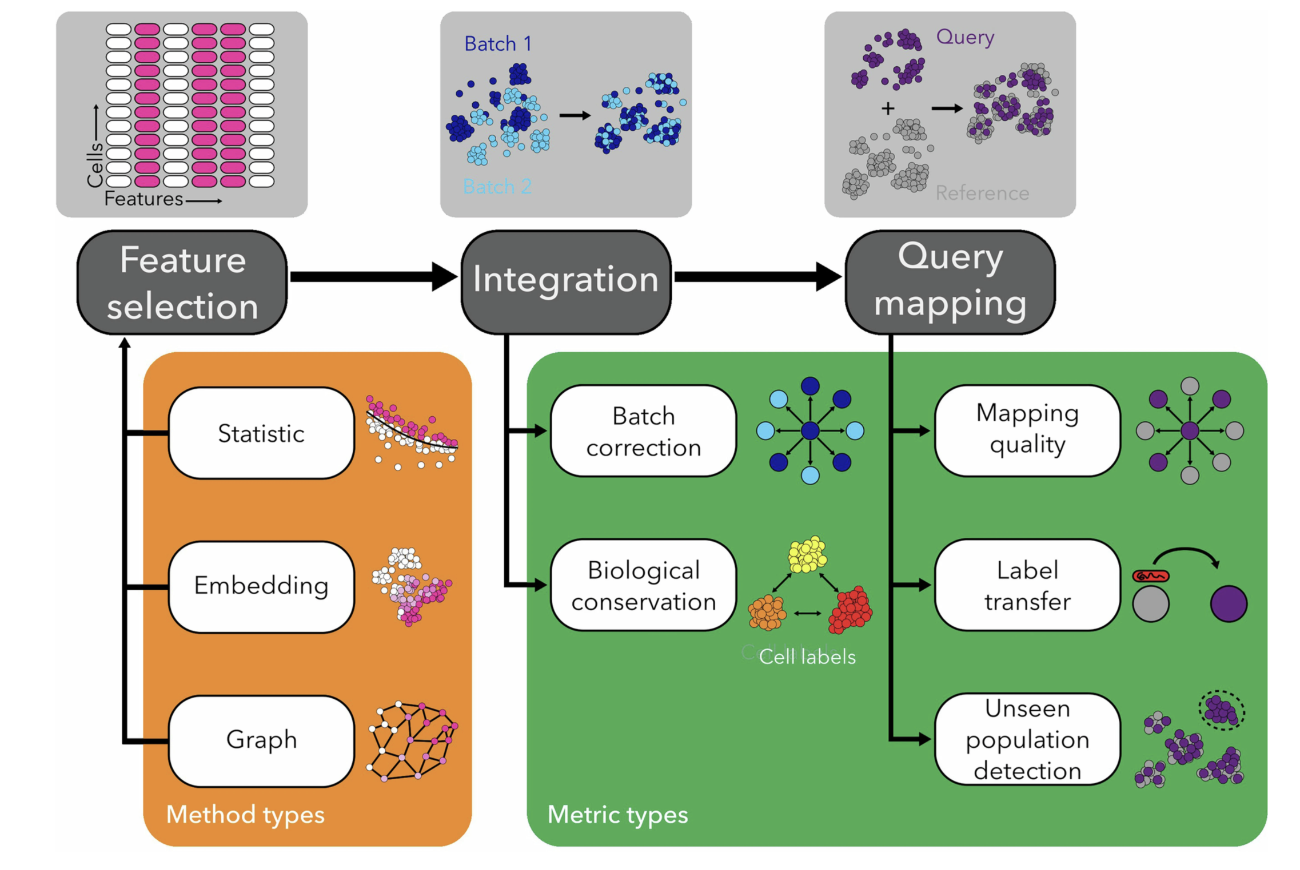
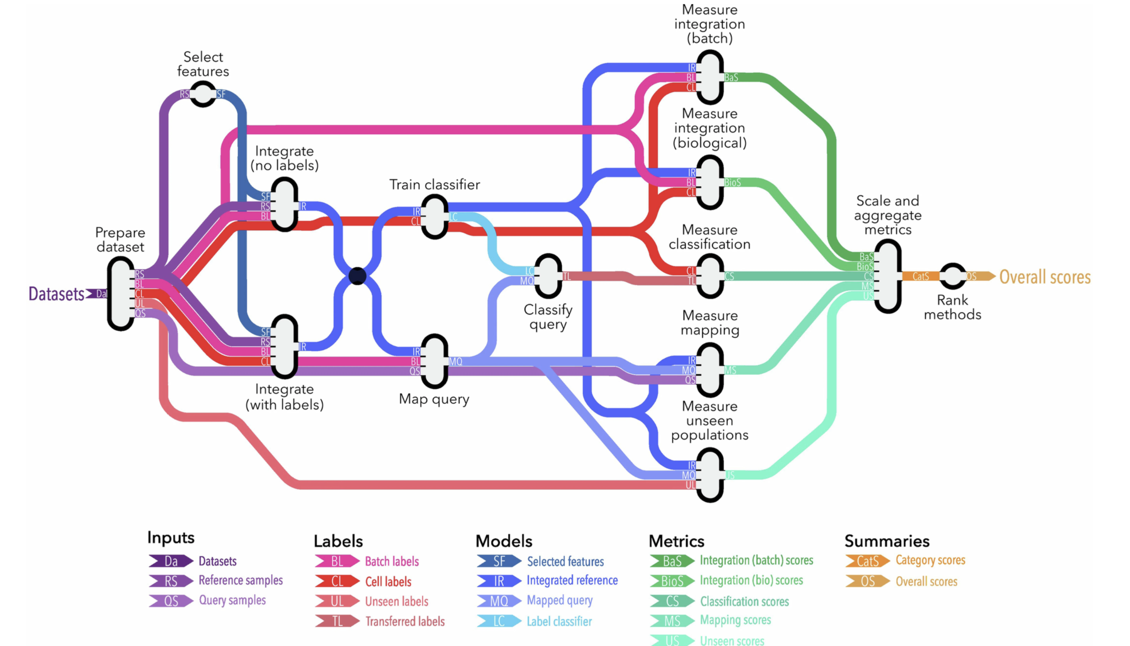
High level extended data figures

